Slide 1
How to Use this Presentation:
Double-check each slide carefully to be sure that all points are applicable to your plans.
Copy and paste the slides into your open enrollment presentation.
To increase your enrollment rate, we recommend that you present these slides after you discuss your medical, vision and dental plans.
If a slide has a video on it, simply click the video to open it in your browser.

Slide 2
Tuition Reimbursement Account

Slide 3
What is a TRA?

Slide 4
Tuition Reimbursement Account
A Tuition Reimbursement Account is a program offered by your employer that can help you pay for your degree, tuition, specialized training, and other costs associated with ongoing education.

Slide 5
Tuition Reimbursement Account
Eligible Expenses
How it Works:
Your employer will reimburse you up to $________ for:
Tuition for college courses
Specialized training that will enhance your skills for work
Pay for your classes or training as you normally do
Submit documentation showing successful completion of the class, degree, or training program and get reimbursed if it is approved

Slide 6
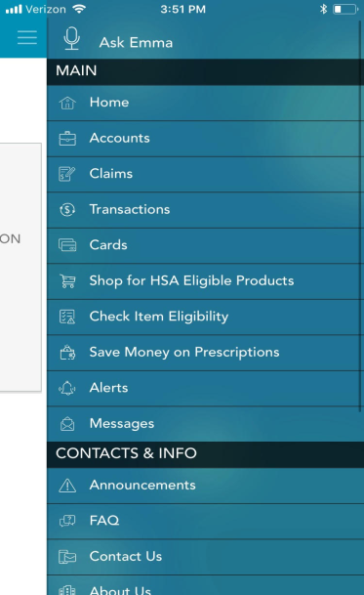
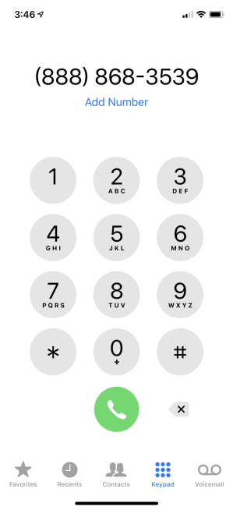
Ameriflex Support
Download the Mobile App
Call Us at
888.868.3539
Visit
www.myameriflex.com

Slide 7
Questions?

